Slide 1

Object – Oriented Programming
Iksan Bukhori, M.Phil.

Slide 2
Topic 6: Four Pillars OF oop

Slide 3
First Pillar: Encapsulation

Slide 4
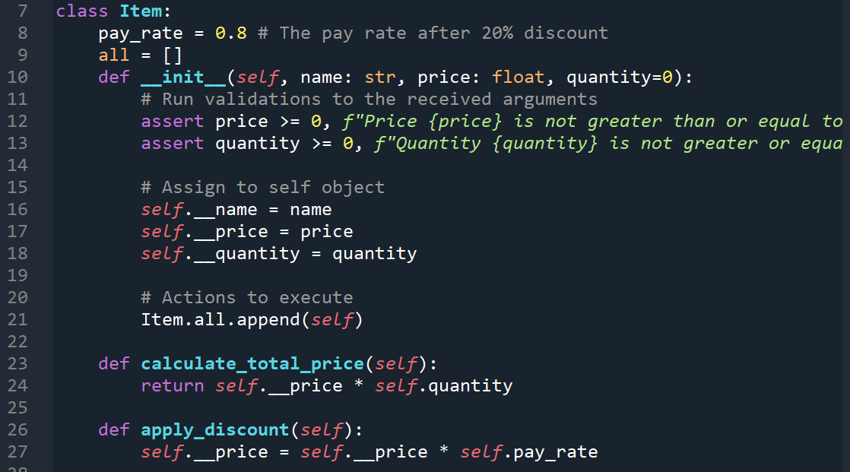
Encapsulation: Private Attribute
Encapsulation refers to prevention of access of attributes and methods that are not supposed to be seen by others outside of the class
This can be done using private modifier as we have studied before

Slide 5
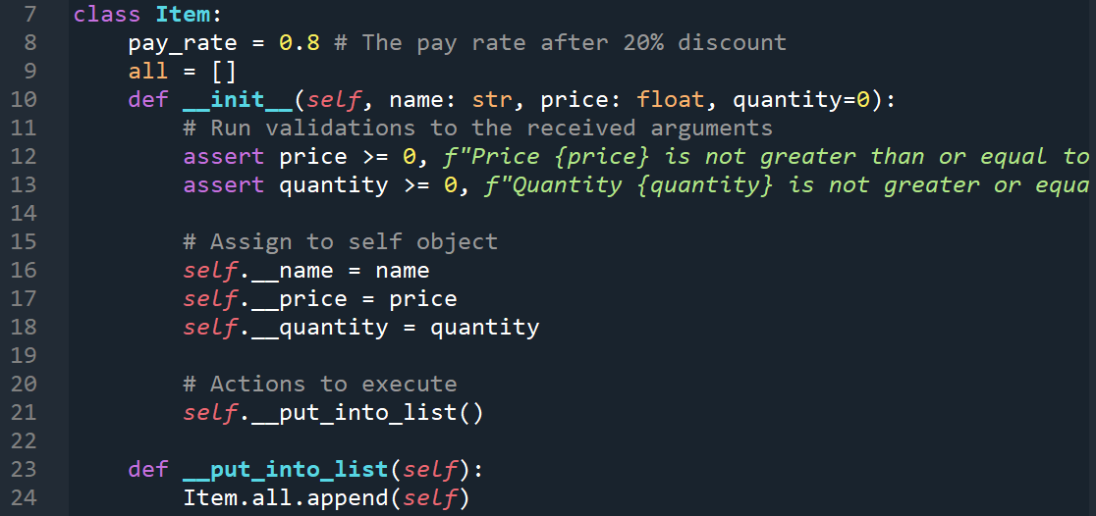
Encapsulation: Private Method and Protected Modifier
Private modifier could also be used for methods
Remember, if one really wants to, he/she may access these private attributes and methods using name mangling that we have discussed before
Another access modifier, protected, is even more loosely useful than private. Thus Protected modifier (using prefix single underscore ‘_’) is more like a convention, telling other programmer that this particular attribute/method is not supposed to be accessed from outside the class

Slide 6
Encapsulation: Property decorator and Getter/Setter Method
Private modifier can be accessed using property decorator which acts like getter method (A method to retrieve private attribute)

Slide 7
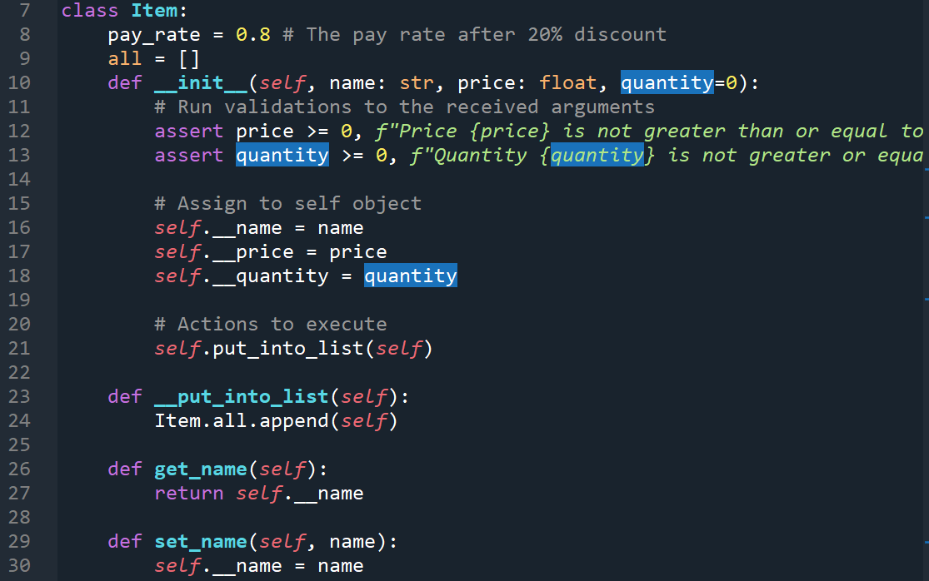
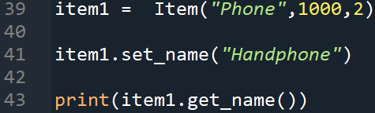
Encapsulation: Property decorator and Getter/Setter Method
In order to get/set private attributes, you may create a get/set method as follows
We can then get/set this attribute using:

Slide 8
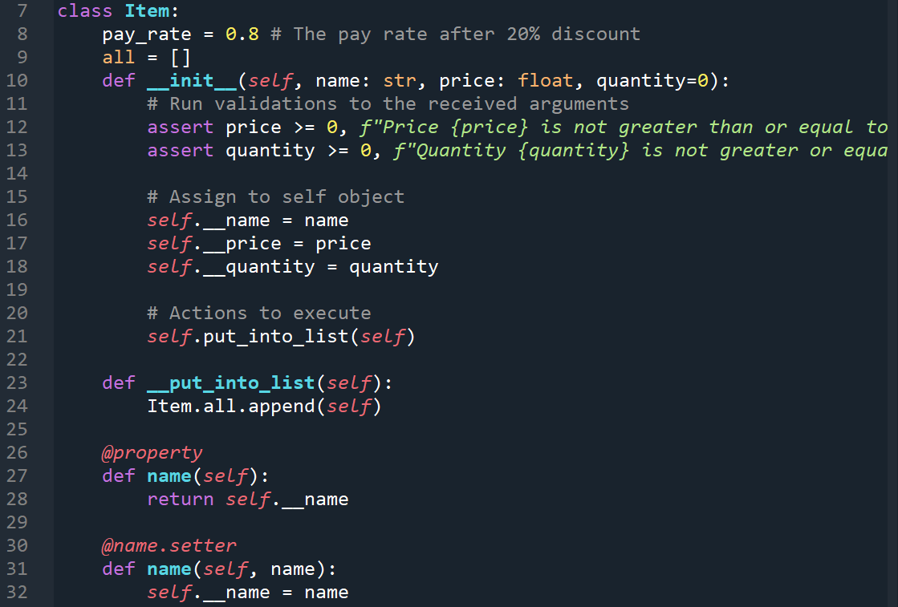
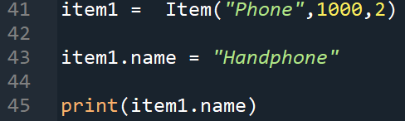
Encapsulation: Property decorator and Getter/Setter Method
A more Pythonic way to create these setter/getter is using property decorator
We can then get/set this attribute using:
Pay attention on how the call to getter/setter is changed when using property decorator

Slide 9
Encapsulation: Property decorator and Getter/Setter Method
Note: Getter needs to be defined first before the corresponding setter is defined

Slide 10
Second Pillar: Abstraction

Slide 11

Abstraction: BlackJAck Example
Abstraction refers to the technique to hide the details of implemented which is unnecessary to be known by the caller
When the user calls a certain method, they do not know how many other methods are called in order to do what they want
For example, consider the simple blackjack game from last week. In order to play the game, the user simply needs to create a new instance of BlackJack Class and calls the run() method. (See below)
This looks simple, eventhough inside the run() method, multiple methods need to be called (See the next page)

Slide 12
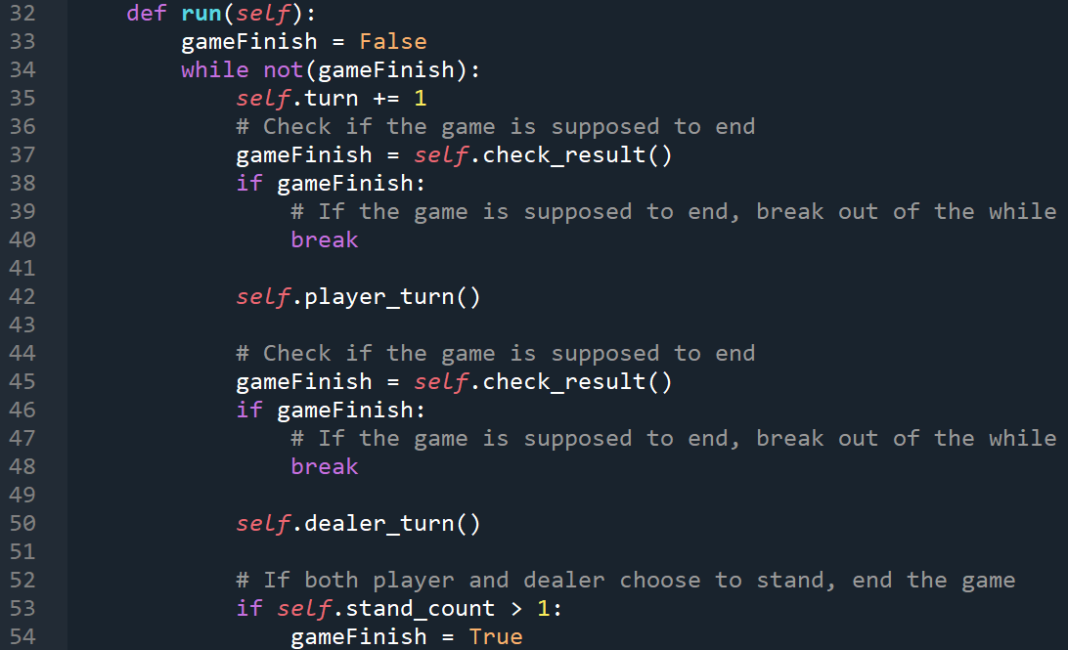
Abstraction: BlackJAck Example
In run() method, at least three methods are called.
In fact, inside each one of these method, a set of other methods are also called

Slide 13
Third Fundamental: Inheritance

Slide 14
Inheritance: Item Example
We have discussed extensively about inheritance using Student Class and Package Class
Now, try to create inheritance using Item Class. Make two child classes, Phone and Laptop to inherit all attributes and methods of Item class
The Child class should override the pay_rate attribute, as phone and laptop may have different discount

Slide 15
Fourth Pillar: Polymorphism

Slide 16
Polymorphism: Item Example
Polymorphism refers to the implementation of a method in multiple ways
In other programming language, we may create two methods of the same name, as long as they have different argument signatures. Which method to be executed depends on which argument signatures are used when calling the method (this is commonly called methods overloading)
In Python, however, we cannot have multiple methods of the same name. The method written last will overwrite the previous one(s)
Therefore, in Python, polymorphism prominently appear in inheritance hierarchy, where a method in child class could override the method of parent class if both methods have the same name

